Slide 1
Probability measure

Slide 2
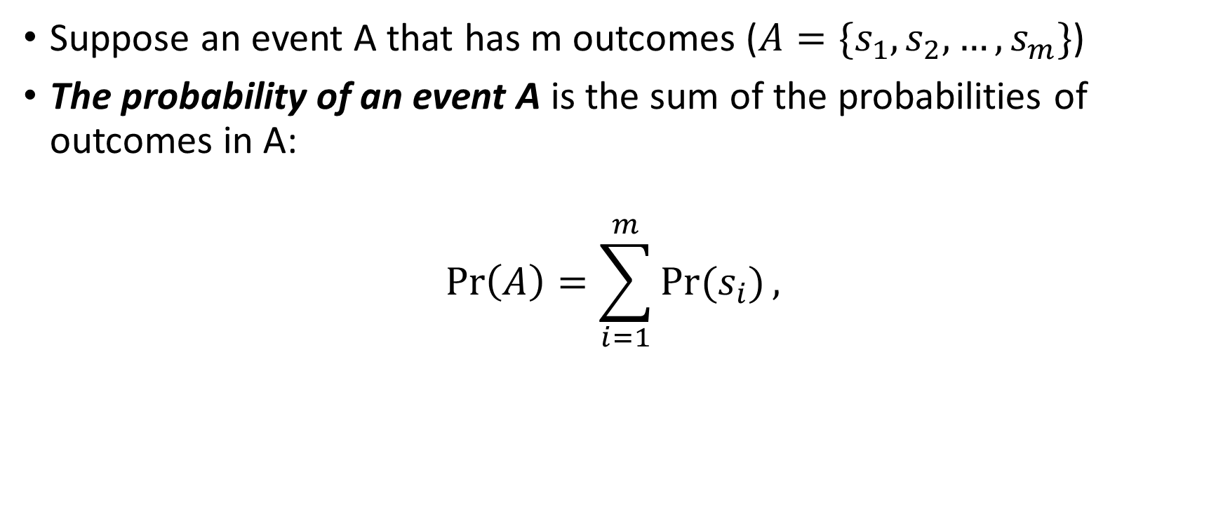
Probability measure
Suppose an event A that has m outcomes (${A=\{s}_{1},s_{2},…,s_{m}\}$)
The probability of an event A is the sum of the probabilities of outcomes in A:
$$\operatorname{Pr}\left(A\right)=\sum_{i=1}^{m}{Pr⁡(s_{i})},$$

Slide 3
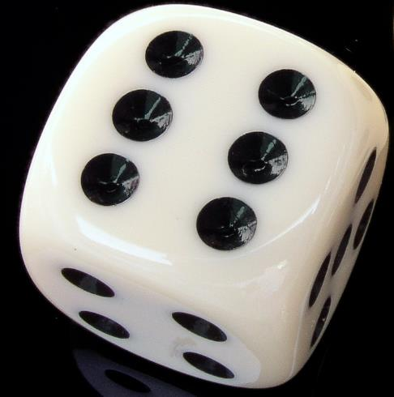


$$S=\{1,2,3,4,5,6\}$$
For a loaded dice, its Pr({1})= Pr({2})= Pr({3})= Pr({4})=0.2, and Pr({5})= Pr({6})=0.1
(1) What is the probability of $A=${2,4,6}?
(2) What is the probability of $S$?

Slide 4

Axiom of probability
The sum of probabilities of all outcomes is 1. That is,
$\operatorname{Pr}\left(S\right)=1$, where S is the sample space of the experiment

Slide 5
Simple sample space
When all outcomes in the sample space has an equal probability, we call this sample space a simple sample space
If the sample space has n discrete outcomes, any outcome in the sample space will have 1/n probability, making the total probability equal to 1.
E.g., there are 40 students in a class. The professor randomly picks a student to answer a question.
Then each student has a probability of 1/40 of being picked by the professor.

Slide 6
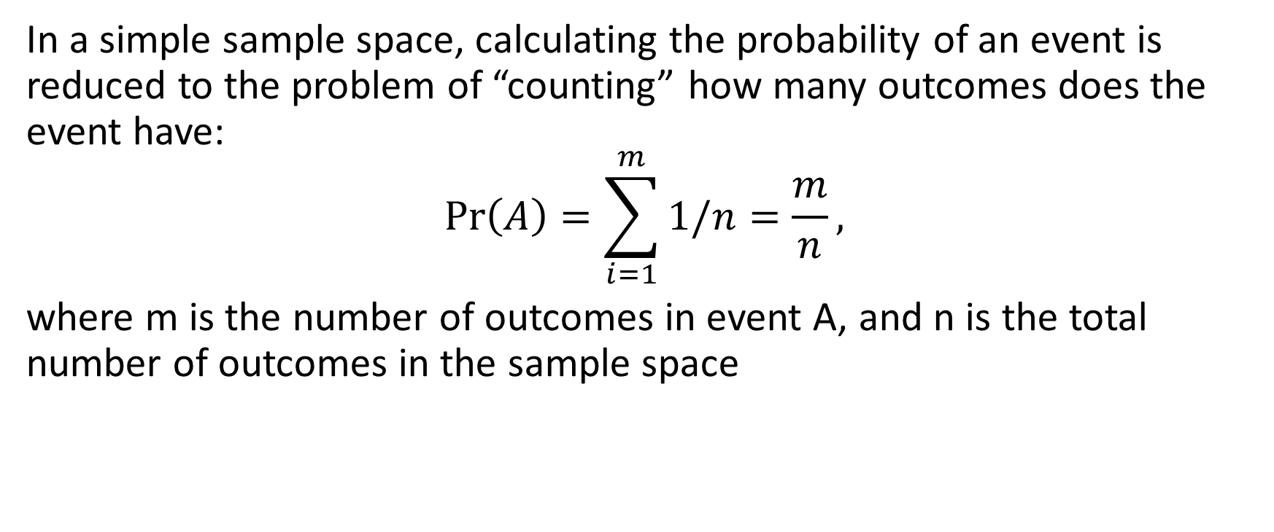
Simple sample space (contd.)
In a simple sample space, calculating the probability of an event is reduced to the problem of “counting” how many outcomes does the event have:
$$\operatorname{Pr}\left(A\right)=\sum_{i=1}^{m}{1/n}=\frac{m}{n},$$
where m is the number of outcomes in event A, and n is the total number of outcomes in the sample space

Slide 7

$$S=\{1,2,3,4,5,6\}$$
Fair dice has its Pr({1})= Pr({2})= Pr({3})= Pr({4})=Pr({5})= Pr({6})=1/6
(1) What is the probability of $A=${2,4,6}?
(2) What is the probability of the event “greater than or equal to 4”?

Slide 8
Interpreting probabilities
How do we explain a 0.5 probability of the event “head” ?
The proportion of observing the event “head,” among any number of experiments, must be 0.5
The proportion of observing the event “head,” among any number of experiments, must be close to 0.5
The proportion of observing the event “head,” with a higher number of experiments, will get closer to 0.5

Slide 9
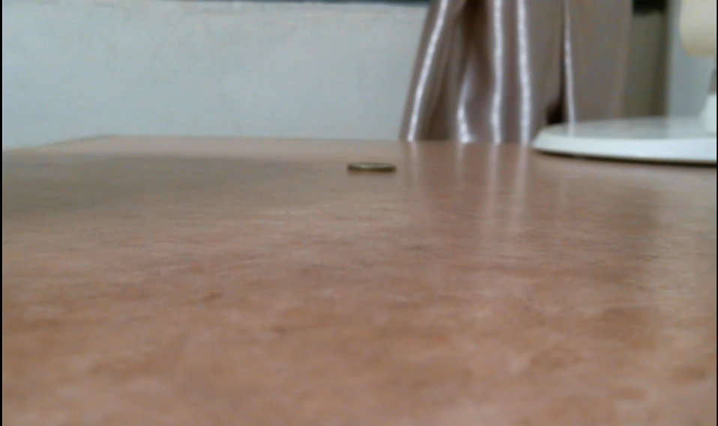
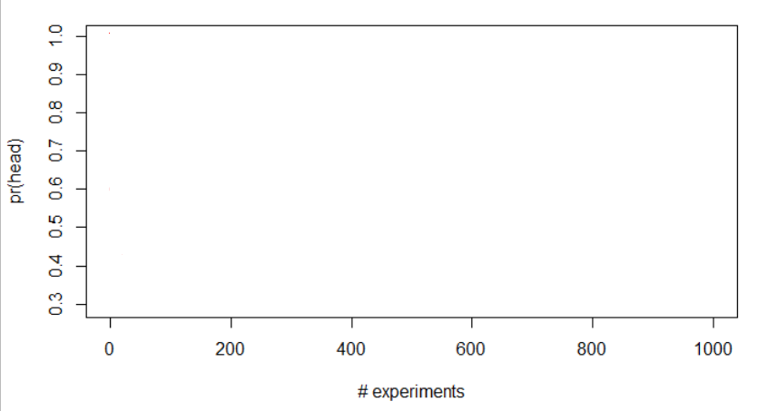
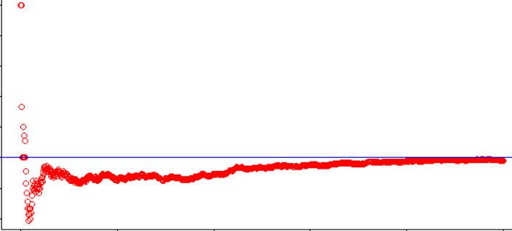

Slide 10
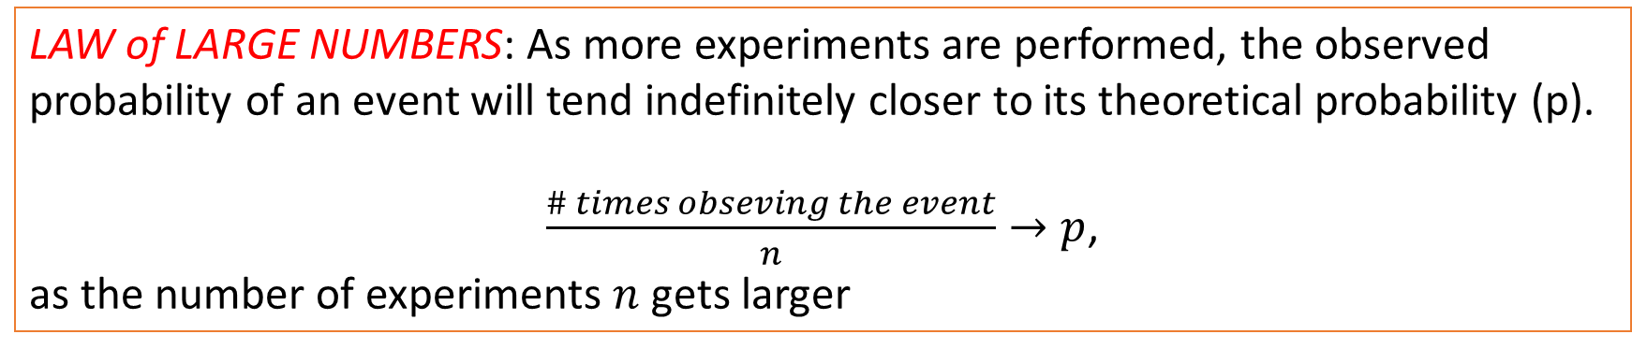
Interpreting probabilities
What does a 0.5 probability of the event “head”?
The proportion of observing the event “head,” with a higher number of experiments, will get closer to 0.5
LAW of LARGE NUMBERS: As more experiments are performed, the observed probability of an event will tend indefinitely closer to its theoretical probability (p).
$\frac{\# times obseving the event}{n}→p$,
as the number of experiments $n$ gets larger

